Slide 1
Routing Protocols (RIP, OSPF, and BGP)

Slide 2
Introduction
An internet is a combination of networks connected by routers
A metric is a cost assigned for passing through a network.
the total metric of a particular route is equal to the sum of the metrics of networks that comprise the route.
the router chooses the route with the shortest (smallest) metric
RIP (Routing Information Protocol) : treating each network equals.
The cost of passing through each network is the same.
so if a packet passes through 10 networks to reach the destination, the total cost is hop counts.

Slide 3
Introduction
OSPF(Open Shortest Path First)
allowing the administrator to assign a cost for passing through a network based on the type of service required.
A route through a network can have different costs (metrics)
BGP (Border Router Protocol)
Criterion is the policy, which can be set by the administrator.
Policy defines what paths should be chosen.
Static and Dynamic tables
Unicast Routing and Multicast Routing

Slide 4
14.1 Intra and Extra Domain Routing
Because an internet can be so large, one routing protocol cannot handle the task of updating routing tables of all routers.
So, an internet is divided into autonomous systems.
An autonomous system (AS) is a group of networks and routers under the authority of a single administration.
Intradomain routing
used for the routing inside an autonomous system
Interdomain routing
used for the routing between autonomous systems

Slide 5
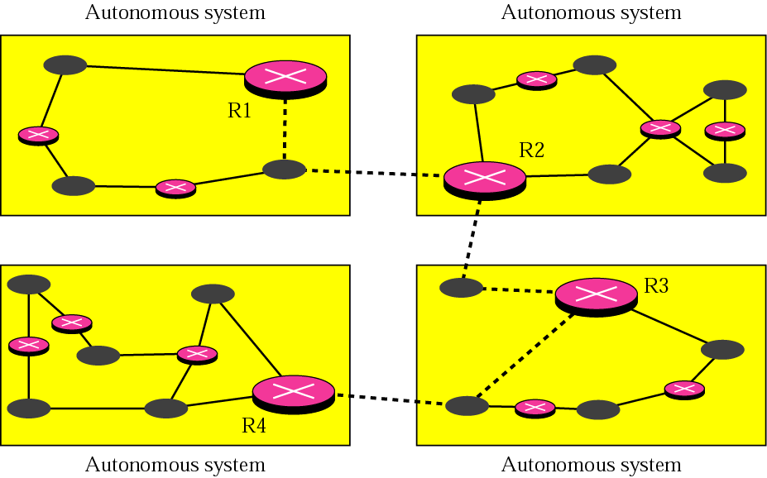
Autonomous Systems
Interdomain routing
Intradomain routing

Slide 6
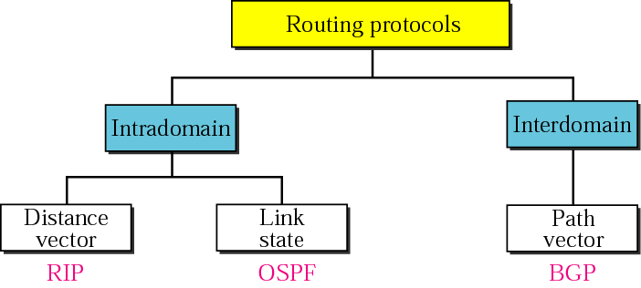
Intra and Extra Domain Routing (Cont’d)
Popular routing protocols

Slide 7
14.2 Distance Vector Routing
In distance vector routing, the least cost route between any two nodes is the route with minimum distance. In this protocol each node maintains a vector (table) of minimum distances to every node
The table at the each node also guides the packet to the desired node by showing the next stop in the route (next-hop routing)
Distance Vector Routing
each router periodically shares its knowledge about the entire internet with neighbors
the operational principles of this algorithm
Sharing knowledge about the entire autonomous system
Sharing only with neighbors
Sharing at regular intervals (ex, every 30 seconds) and when there is a change

Slide 8
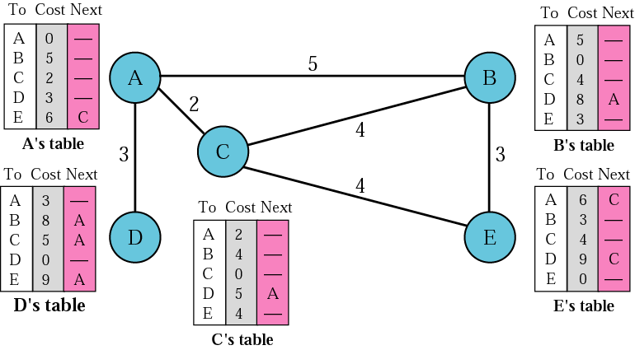
Distance Vector Routing Tables

Slide 9
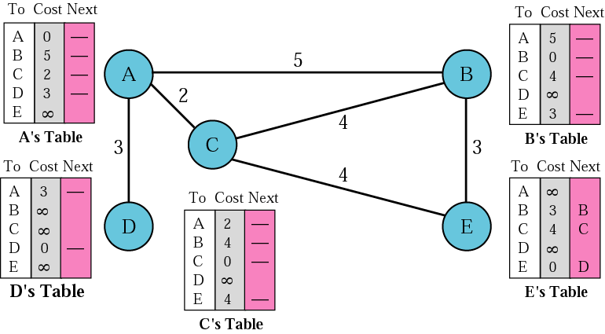
Initialization of Tables in Distance Vector Routing

Slide 10
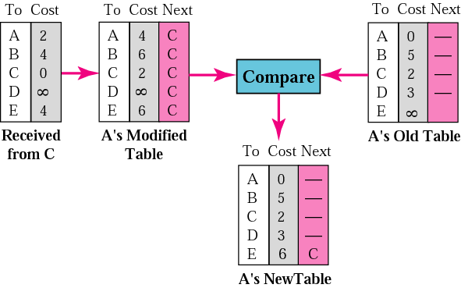
Updating in Distance Vector Routing
In distance vector routing, each node shares its routing table with its immediate neighbors periodically and when there is a change.

Slide 11
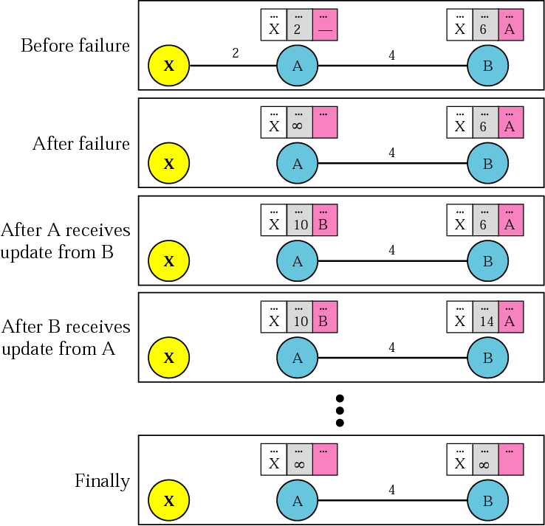
Two-Node Loop Instability

Slide 12
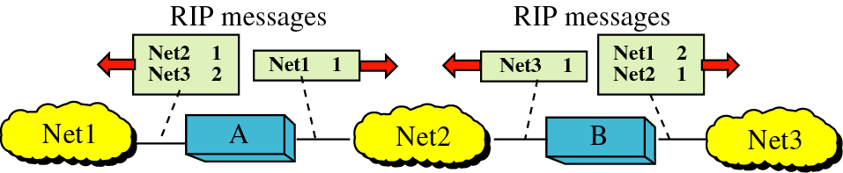
Distance Vector Routing
Some Remedies for Instability
Split Horizons

Slide 13
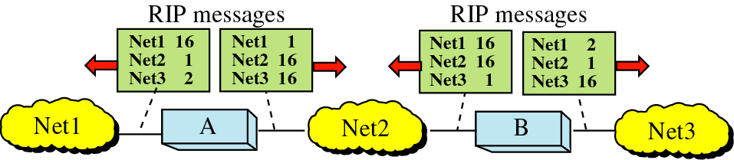
Distance Vector Routing
Poison Reverse : a variation of split horizons

Slide 14
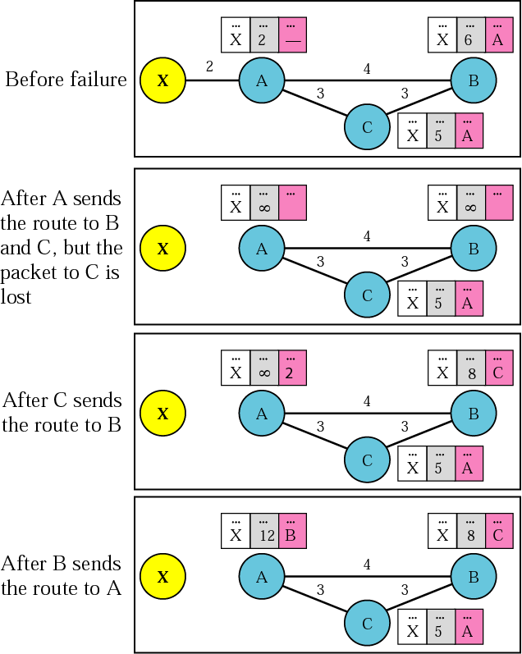
Three-Node Instability

Slide 15
14.3 RIP
The Routing Information Protocol (RIP) is an intradomain routing protocol used inside an autonomous system. It is a very simple protocol based on distance vector routing.
The destination in a routing table is a network, which means the first column defines a network address.
A metric in RIP is called a hop count; distance; defined as the number of links (networks) that have to be used to reach the destination.

Slide 16
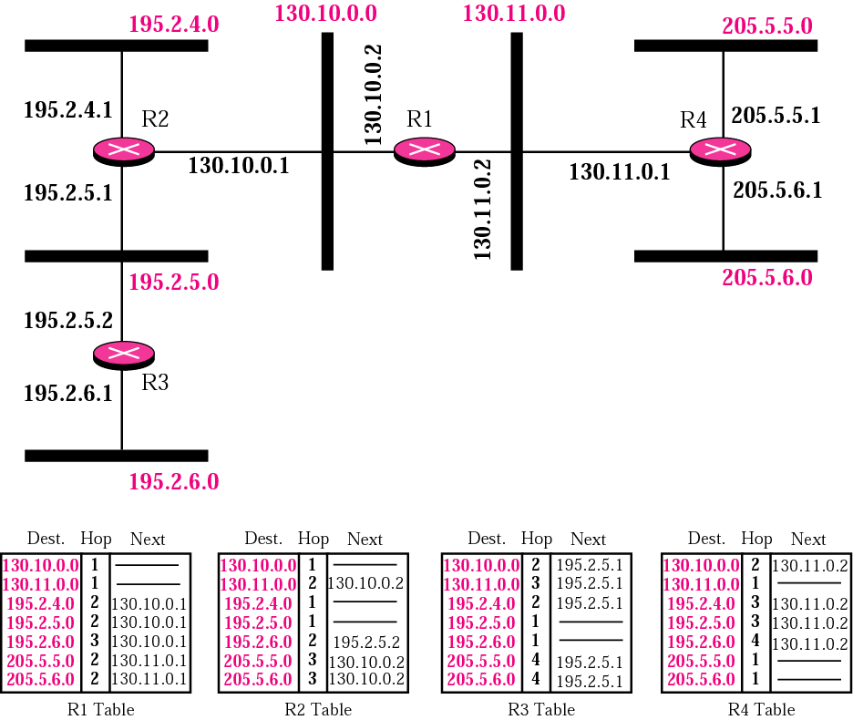
Example of a Domain Using RIP

Slide 17
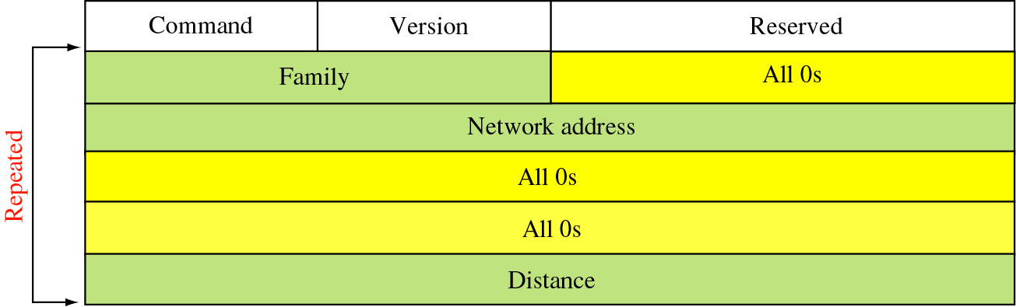
RIP (cont’d)
RIP Message Format
Command : request (1) or response (2)
Version
Family : For TCP/IP the value is 2
Address : destination network address
Distance : defining the hop count from the advertising router to the destination network
* Part of the message (entry) is repeated for each destination network.

Slide 18
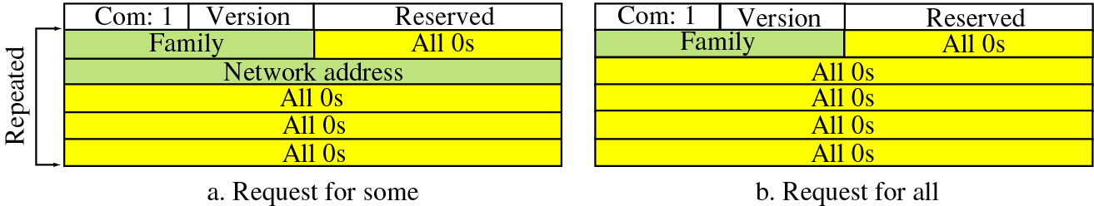
RIP (cont’d)
Requests and Response
Request messages : sent by a router that has just come up or by a router that has some time-out entries.

Slide 19
RIP (cont’d)
Response
solicited response
is sent only in answer to a request
containing information about the destination specified in the corresponding request
unsolicited response
is sent periodically, every 30 seconds
containing information covering the whole routing table

Slide 20
Example 1
Figure 14.11 shows the update message sent from router R1 to router R2 in Figure 14.8. The message is sent out of interface 130.10.0.2.

Slide 21
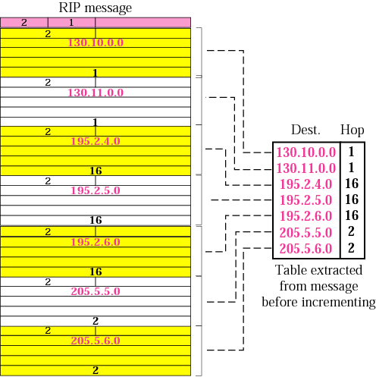
Solution to Example 1

Slide 22
RIP (cont’d)
Timers in RIP
Periodic timer : controlling the advertisements of regular update messages
expiration timer : governing the validity of a route
the garbage collection timer : advertising the failure of a route
Periodic timer
controlling the advertising of regular update messages
using random number between 25 to 35 seconds

Slide 23
RIP (cont’d)
Expiration timer
In normal situation, the new update for a route occurs every 30 seconds
But, if there is a problem on an Internet and no update is received within the allotted 180 seconds, the route is considered expired and the hop count of the route is set to 16.
Each router has its own expiration timer.
Garbage Collection Timer
When the information about a route becomes invalid, the router continues to advertise the route with a metric value of 16 and the garbage collection timer is set to 120 sec for that route
When the count reaches zero, the route is purged from the table.

Slide 24
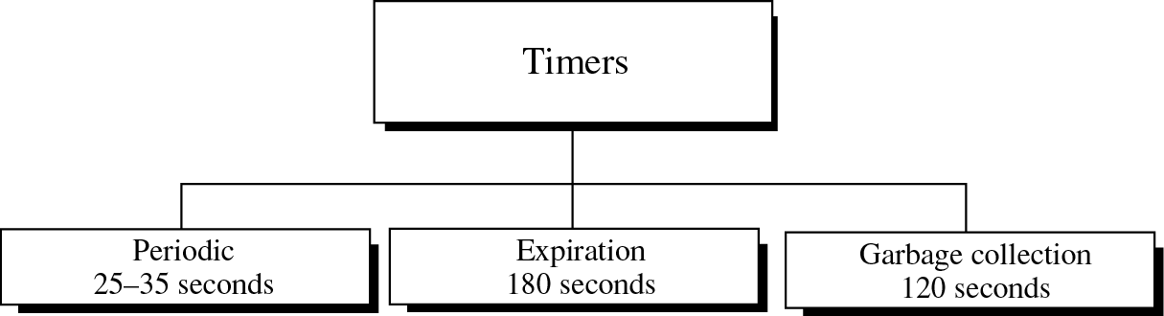
RIP (cont’d)
RIP timers

Slide 25
RIP (cont’d)
Example 2
A routing table has 20 entries. It does not receive information about five routes for 200 seconds. How many timers are running at this time?
The timers are listed below:
Periodic timer: 1
Expiration timer: 20 - 5 = 15
Garbage collection timer: 5

Slide 26
RIP Version 2
Designed for overcoming some of the shortcomings of version 1
Replaced fields in version 1 that were filled with 0s for the TCP/IP protocols with some new fields
Can use classless addressing

Slide 27
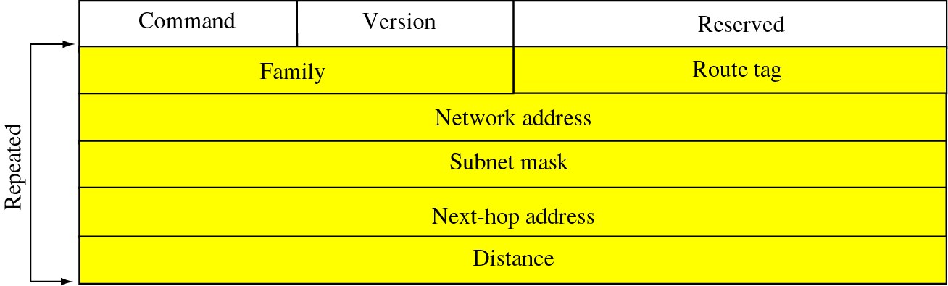
RIP Version 2 (cont’d)
RIP version 2 format
Route Tag : carrying information such as the autonomous system number
Subnet mask : carrying the subnet mask
Next-hop address : showing the next hop
In case that shares a network backbone by two ASs, the message can define the router to which the packet should go next

Slide 28
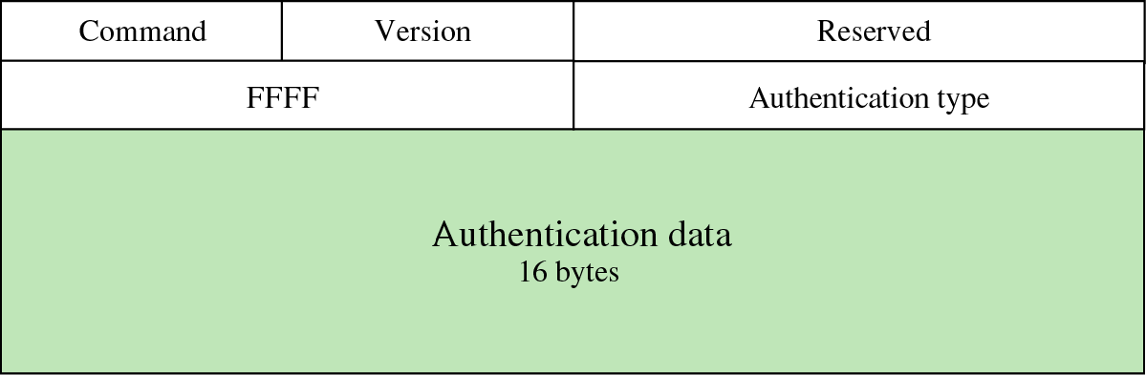
RIP Version 2 (cont’d)
Authentication
added to protect the message against unauthorized advertisement
Value of FFFF₁₆ is entered in the family field
Authentication type : protocol used for authentication

Slide 29
RIP Version 2 (cont’d)
Multicasting
Using the multicast address 224.0.0.9 to multicast RIP messages only to RIPv2 routers in the network
Encapsulation of RIP messages
encapsulated in UDP user datagram
not included a field that indicates the length of the message
Well-known port assigned to RIP in UDP is port 520

Slide 30
14.4 Link State Routing
In link state routing, if each node in the domain has the entire topology of the domain, the node can use Dijkstra’s algorithm to build a routing table.

Slide 31
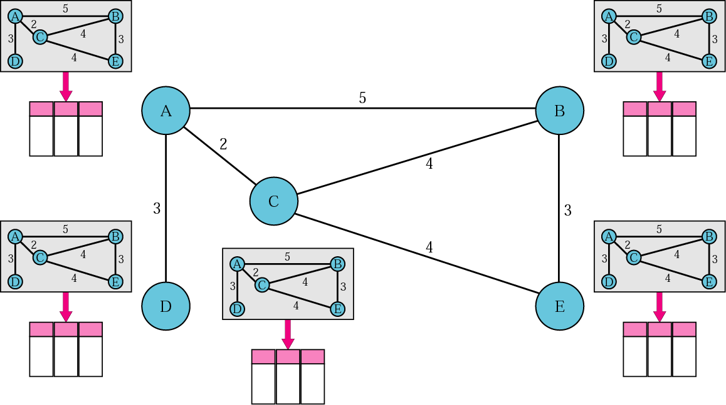
Concept of Link State Routing

Slide 32
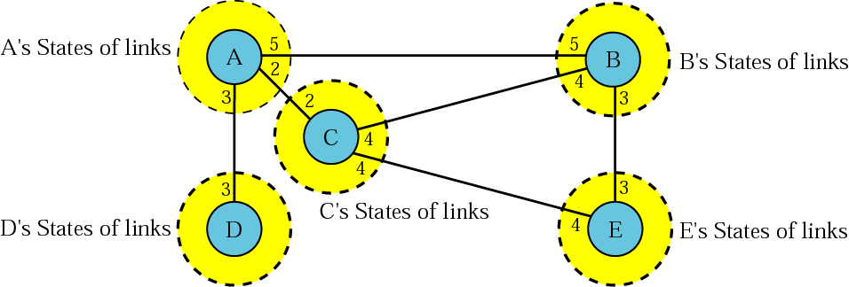
Link State Knowledge

Slide 33
Building Routing Tables
Creation of the states of the links by each node, called the link state packet or LSP.
Dissemination of LSPs to every other router, called flooding, in an efficient and reliable way
Formation of a shortest path tree for each node
Calculation of a routing table based on the shortest path tree

Slide 34
Creation of LSP
When there is a change in the topology of the domain
On a periodic basis
60 minutes or 2 hours

Slide 35
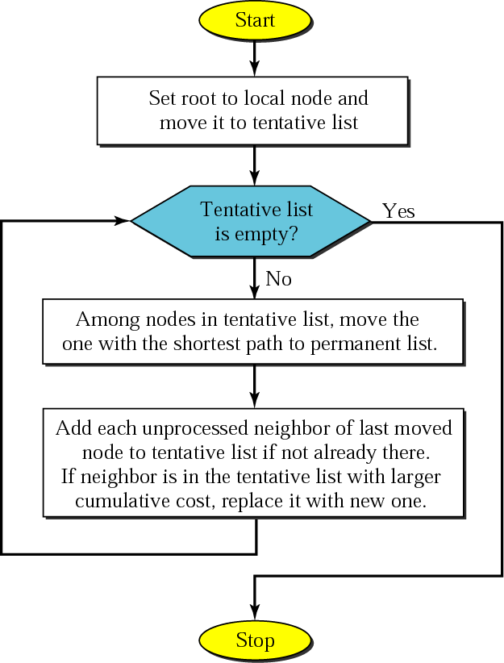
Formation of Shortest Path Tree
Dijkstra Algorithm

Slide 36
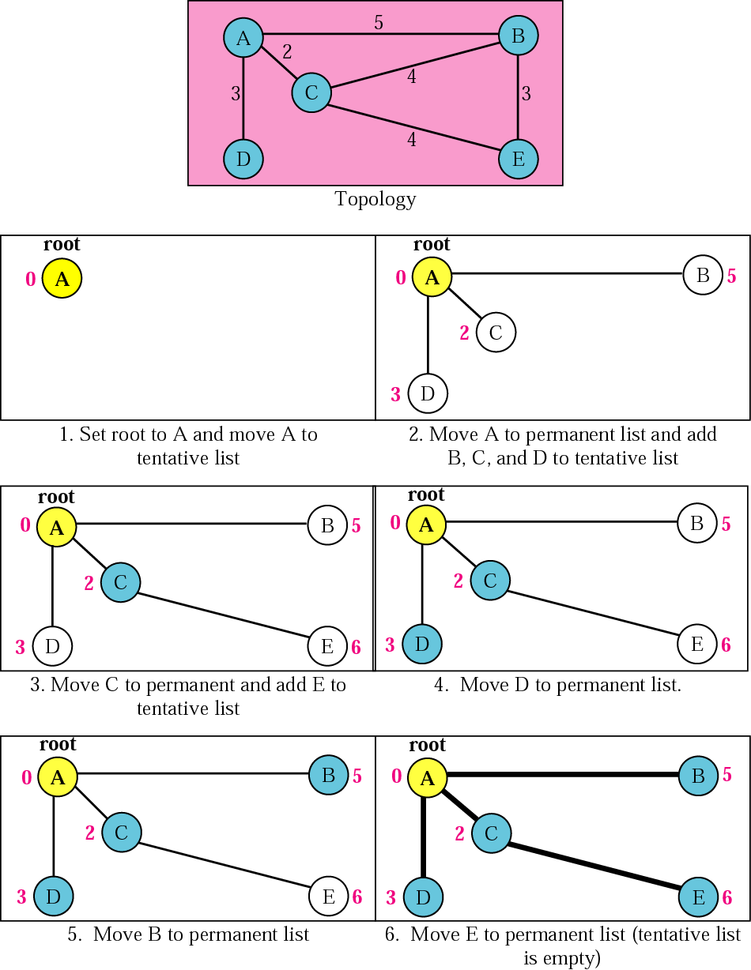
Example of formation of Shortest Path Tree

Slide 37
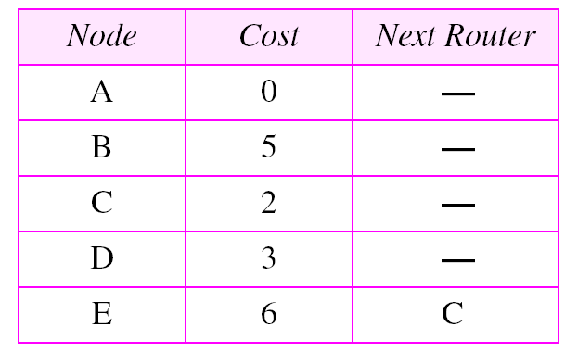
Calculating of Routing Table from Shortest Path Tree
Table 14.1 Routing table for node A

Slide 38
14.5 OSPF (Open Shortest Path First)
The Open Shortest Path First (OSPF) protocol is an intradomain routing protocol based on link state routing. Its domain is also an autonomous system
Dividing an AS into areas
to handle routing efficiently and in a timely manner

Slide 39
OSPF (cont’d)
Areas
Is a collection of networks, hosts, and routers in AS
AS can be divided into many different areas.
All networks inside an area must be connected.
Routers inside an area flood the area with routing information.
Area Border Router
Summarizes the information about the area and sends it to other areas
Backbone
All of the areas inside an AS must be connected to the backbone
Serving as a primary area (Area 0)
Consisting of backbone routers
Back bone routers can be an area border router

Slide 40
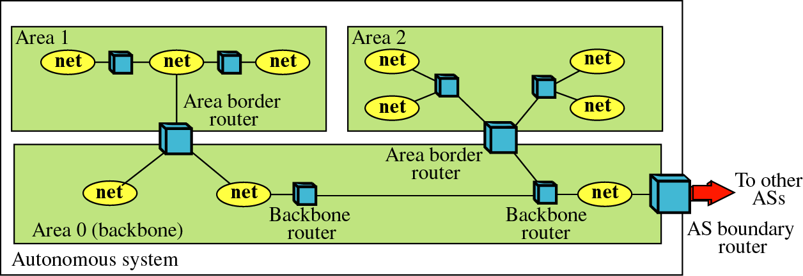
OSPF (cont’d)
Areas in an AS

Slide 41
OSPF (cont’d)
Metric
OSPF protocol allows the administrator to assign a cost, called the metric, to each route.
Based on a type of service (minimum delay, maximum throughput, bandwidth and so on).
A router can have multiple routing tables, each based on a different type of service.
Link State Routing
OSPF uses Link State Routing to update the routing tables in an area
Each router shares its knowledge about its neighborhood with every router in the area.

Slide 42
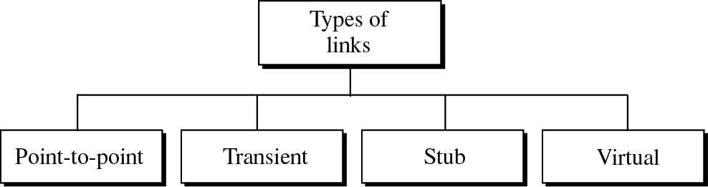
OSPF (cont’d)
Types of Links
In OSPF terminology, a connection is called a link.

Slide 43
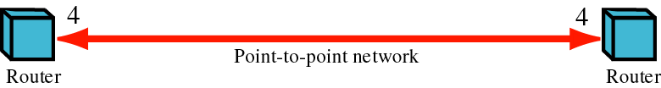
OSPF (cont’d)
Point-to-point Link
Routers are represented by nodes and the link is represented by a bidirectional edge connecting the nodes.
Each router has only one neighbor at the other side of the link.

Slide 44
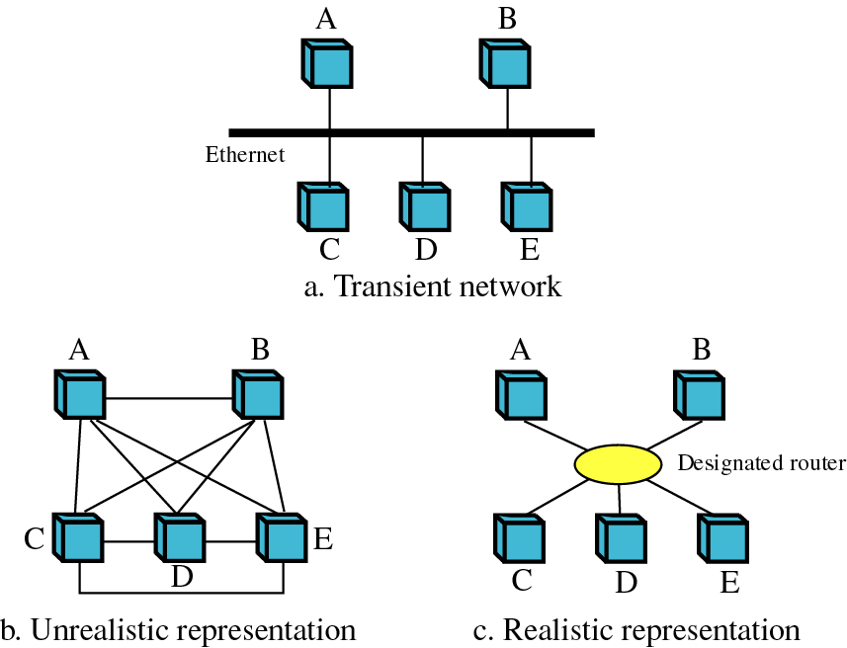
OSPF (cont’d)
Transient Link
is a network with several routers attached to transient Link
(network)

Slide 45
OSPF (cont’d)
In “c”, each router has only one neighbor, the designated router (network)
The designated router has five neighbors.
Number of neighbor announcements is reduced from 20 to 10
There is no metric from the designated router to any other node.
Because the designated router represents the network.

Slide 46
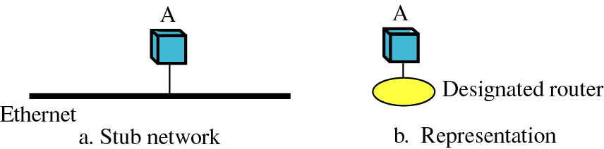
OSPF (cont’d)
Stub Link
is a network that is connected to only one router
is a special case of transient network
The link is only one-directional, from the router to the network.

Slide 47
OSPF (cont’d)
Virtual Link
When the link between two routers is broken, the administration may create a virtual link between them using a longer path

Slide 48
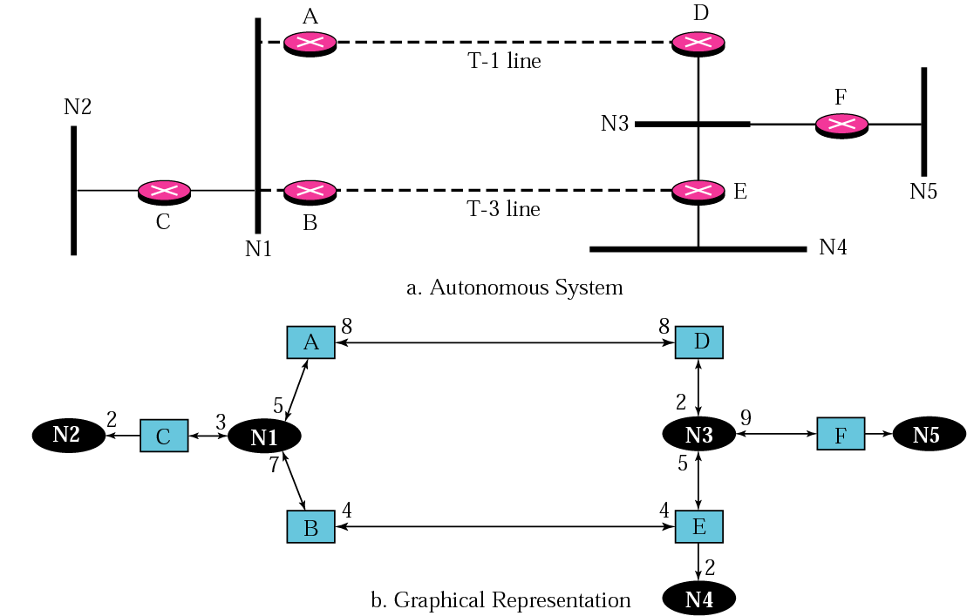
AS and its Graphical Representation in OSPF

Slide 49
AS and its Graphical Representation in OSPF
Graphical Representation (cont’d)
N1, N3 : transient, N2, N4, N5 : Stub
using square nodes for the routers and ovals for the networks

Slide 50
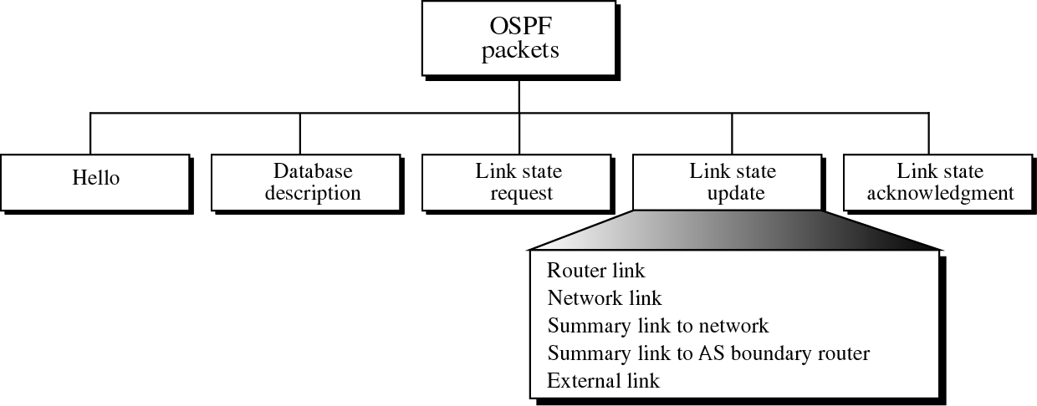
OSPF Packets
Types of OSPF Packets (Messages)

Slide 51
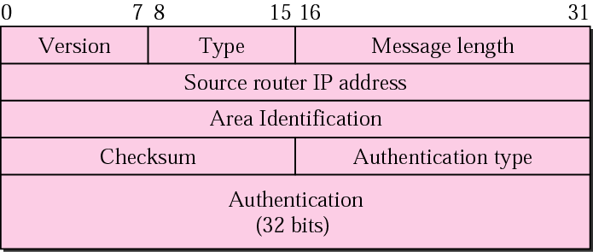
OSPF (cont’d)
OSPF Common Header
authentication type : 0 for none, 1 for password
packet type : five types
Or 64 bits

Slide 52
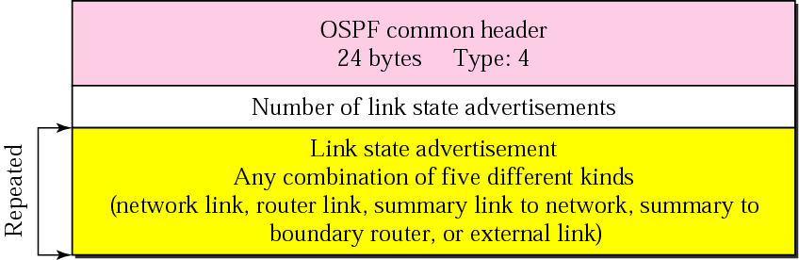
Link State Update Packet
Used by a router to advertise the states of its links

Slide 53
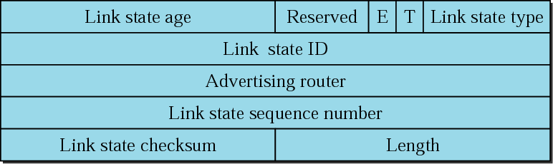
LSA General Header
Link state age
When a router creates the message, the value of this field is 0
When each successive router forwards this message, it estimates the transit time and adds it to the cumulative value of this field.

Slide 54
LSA General Header
E flag : 1 means that the area is a stub area
T flag : 1 means that the router can handle multiple types of service
Link state type : 1) router link, 2) network link, 3) summary link to network, 4) summary link to AS boundary router

Slide 55
LSA General Header
Advertising router
The IP address of the router advertising this message
Link state sequence number
A sequence number assigned to each link state update message

Slide 56
LS Type & LS ID
Link state type | Link state ID
Router link | IP address of the router
Network link | IP address of the designated router
Summary link to network | Address of the network
Summary link to AS boundary | IP address of the boundary router
External link | Address of the network

Slide 57
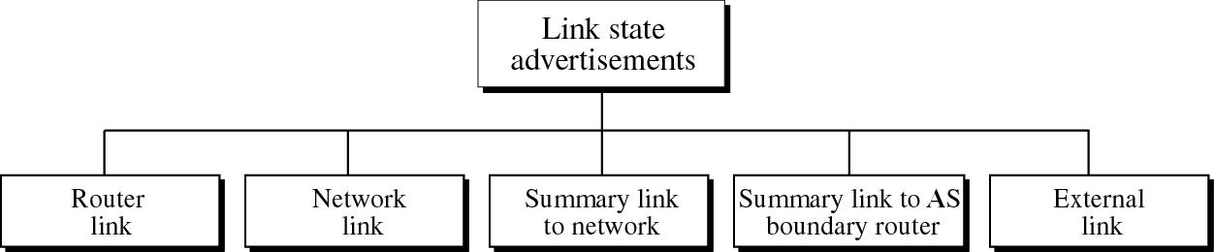
LSA
Link State Advertisements
to share information about neighbors, each router distributes link state advertisements (LSAs)

Slide 58
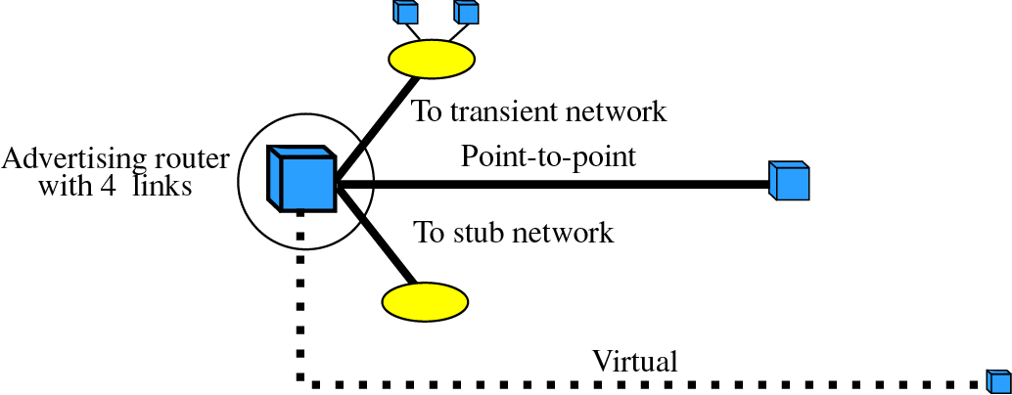
Router Link LSA
Router Link
defining the links of a true router
A true router uses the advertisement to announce information about all of its links and what is at the other side of the link (neighbors)

Slide 59
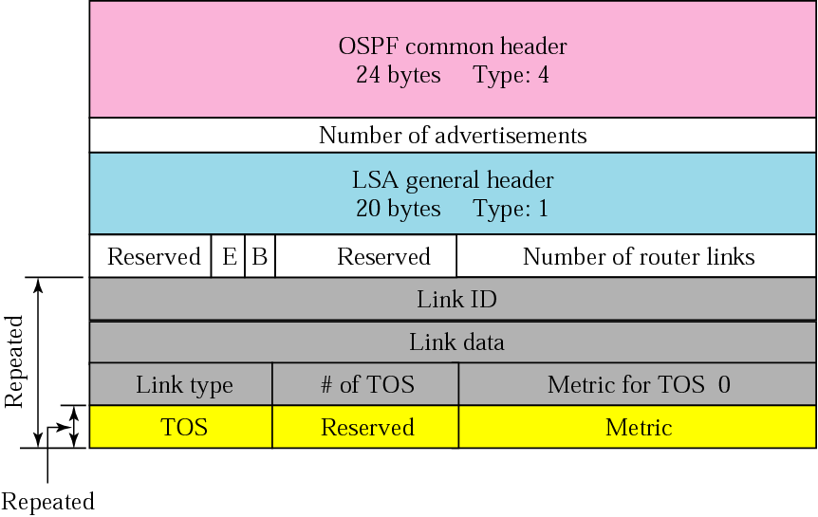
Router Link LSA (cont’d)

Slide 60
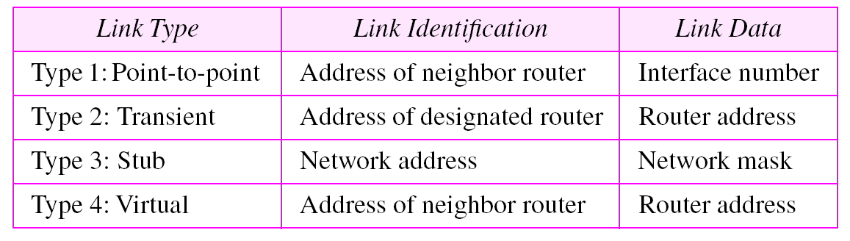
Router Link LSA (cont’d)
Table 14.2 Link types, link identification, and link data

Slide 61
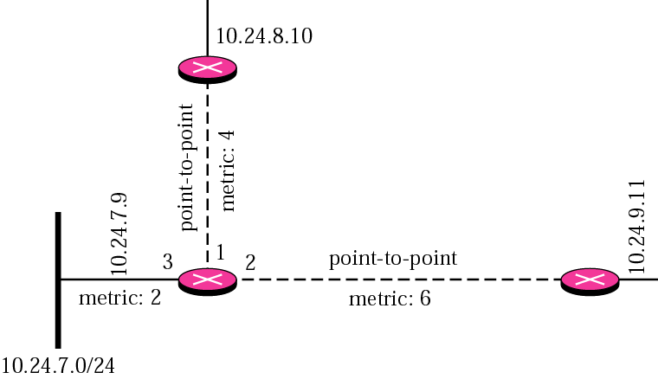
Example 3
Give the router link LSA sent by router 10.24.7.9 in Figure 14.31.

Slide 62
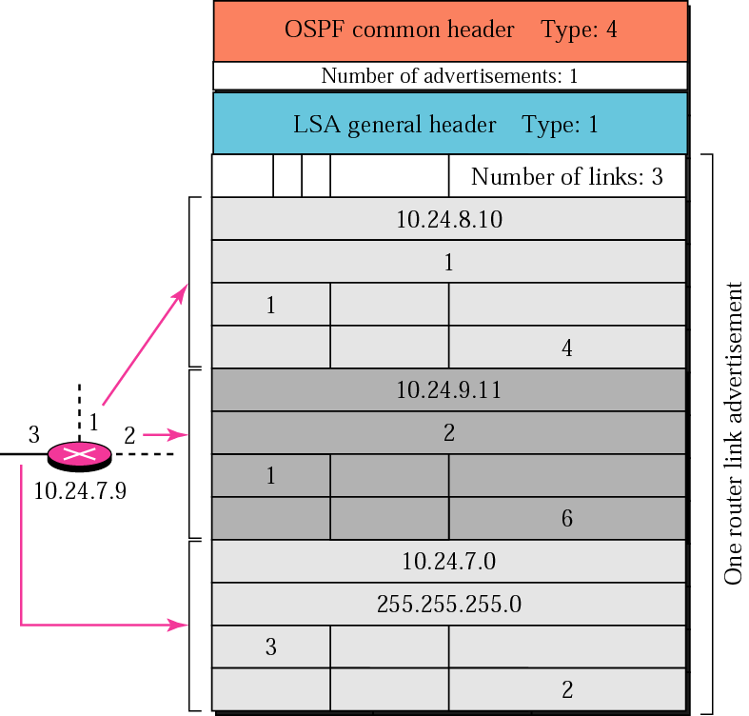
Example 3 : solution

Slide 63
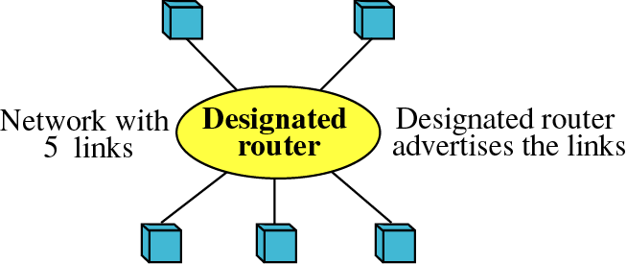
Network LINK LSA
Network Link
defines the links of a network
A designated router distributes this type of LSA packet.
The packet announces the existence of all of the routers connected to the network.

Slide 64
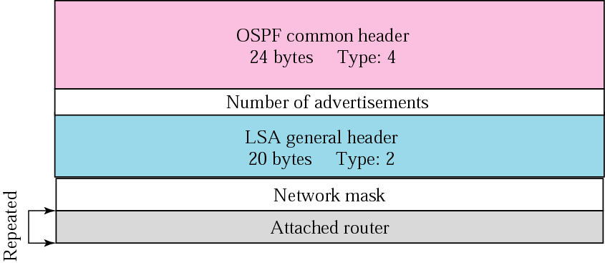
Network LINK LSA
Network Link Advertisement Format

Slide 65

Example 4
Give the network link LSA in Figure 14.35.

Slide 66
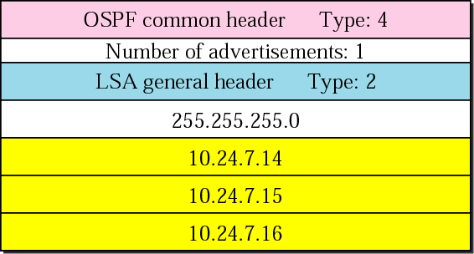
Example 4 : solution

Slide 67
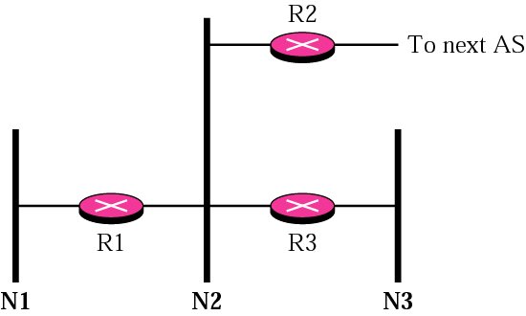
Example 5
In Figure 14.37, which router(s) sends out router link LSAs?

Slide 68
Example 5, 6 : Solution
Example 5 :Solution All routers advertise router link LSAs. a. R1 has two links, N1 and N2. b. R2 has one link, N2. c. R3 has two links, N2 and N3.
In Figure 14.37, which router (s) sends out Network link LSAs?
Example 6 :Solution
All three network must advertise network links: a. Advertisement for N1 is done by R1 because it is the only attached router and therefore the designated router.
b. Advertisement for N2 can be done by either R1, R2, or R3, depending on which one is chosen as the designated router.
c. Advertisement for N3 is done by R3 because it is the only attached router and therefore the designated router.

Slide 69
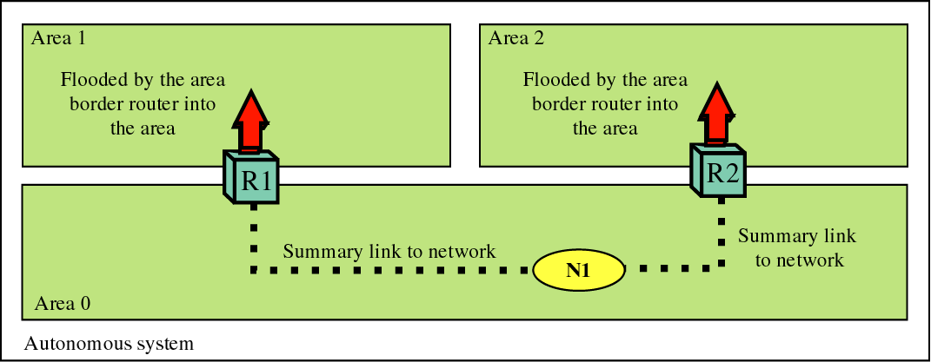
Summary Link to Network LSA
An border router is active in more than one area and creates routing table for each area.
Router R1 floods area 1 with information about how to reach a network located in area 0.

Slide 70
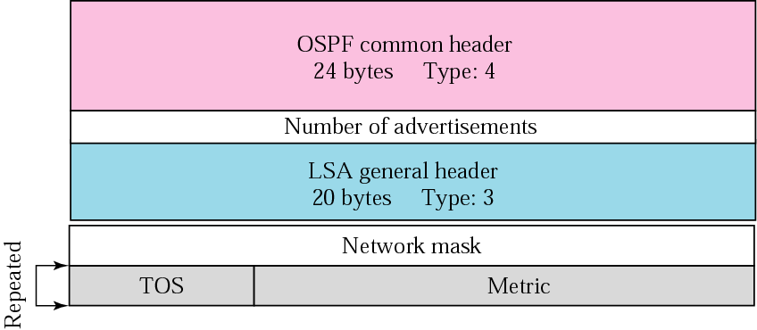
Summary Link to Network LSA (cont’d)

Slide 71
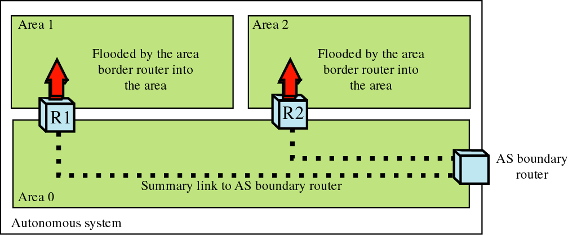
Summary Link to AS Boundary Router
providing the information of the route to an autonomous system boundary router
used for a router that sends a packet outside the autonomous system

Slide 72
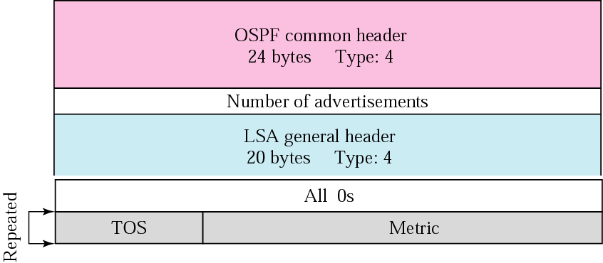
Summary Link to AS Boundary Router (cont’d)

Slide 73
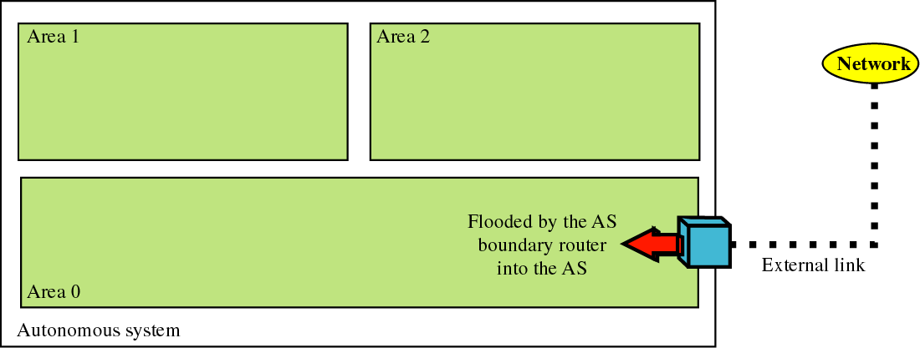
External Link
used to know which networks are available outside the autonomous system

Slide 74
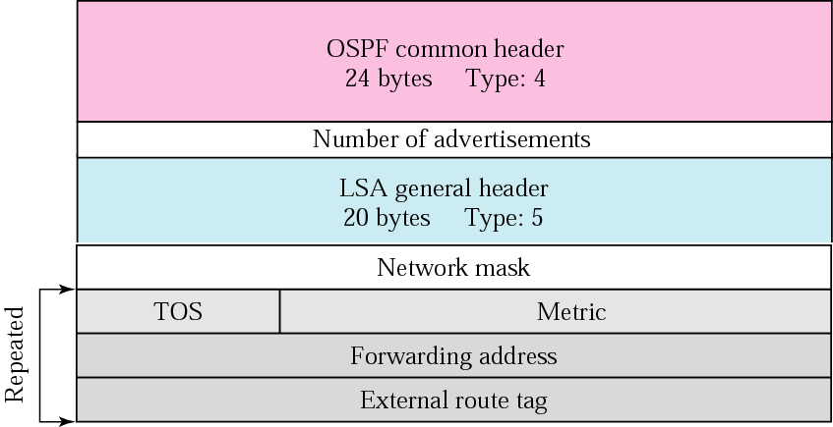
External Link (cont’d)

Slide 75
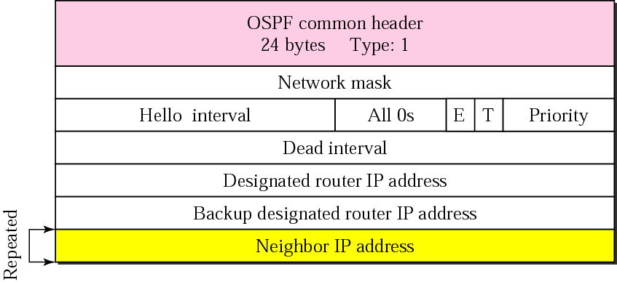
Other Packets
Hello message
uses to create neighborhood relationships and to test the reachability of neighbors
is the first step in link state routing

Slide 76
Other Packets (cont’d)
Database description message
When router is connected to the system for the first time or after a failure, it needs the complete link state database immediately
used when a router is connected to the system for the first time or after a failure
After a router is connected to the system, the router sends hello packets to greet its neighbor.
If it is first time that neighbors hear from the router, they send a database description packet.
The packet does not contain complete database information
Then, the router sends one or more link state request packets to get full information about that particular link
Link State Request Packet
is sent by a router that needs information about a specific route or routes
It is answered with a link state update packet.

Slide 77
Other Packets (cont’d)
Link state acknowledgment packet
OSPF makes routing more reliable by forcing every router to acknowledge the receipt of every link state update packet.
Link State Update Packet
used by a router to advertise the states of its links

Slide 78
Encapsulation of OSPF Packets
Encapsulation
OSPF packets are encapsulated in IP datagram
These packets contain the acknowledgment mechanism for flow and error control
Do not need a transport layer protocol to provide these services

Slide 79
14.6 Path Vector Routing
is similar to distance vector routing
Assuming that there is one node in each AS that acts as on behalf of the entire AS : Speaker Node
Speaker node creates a routing table and advertises it speaker nodes in the neighboring ASs
advertising the path, not the metric of the nodes

Slide 80
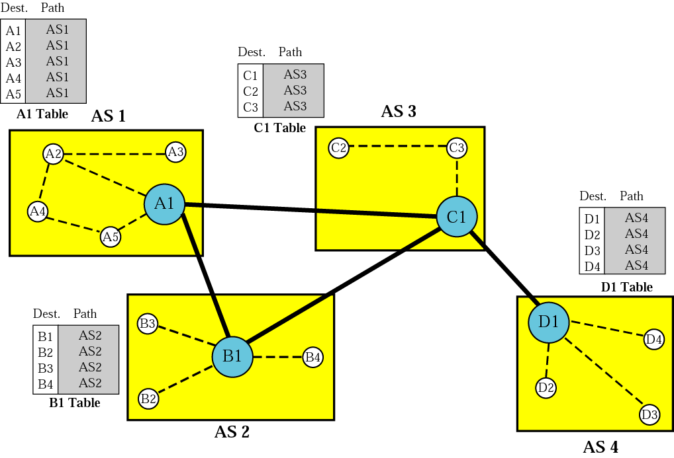
Path Vector Routing (cont’d)
Initialization
Each speaker node can know only the reachability of nodes inside its AS

Slide 81
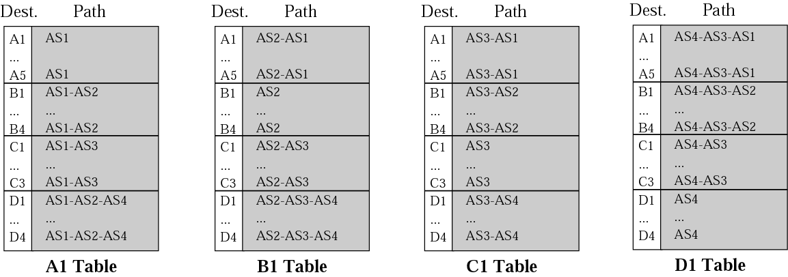
Path Vector Routing (cont’d)
Sharing and Updating
- AS3 -
- AS3 -

Slide 82
14.7 BGP
Border Gateway Protocol is an interdomain routing protocol using path vector routing
Distance vector routing and link state routing
distance vector routing : just considering the number of hops
link state routing : requiring each router to have a huge link state database
Path Vector Routing
Each entry in the routing table contains the destination network, the next router, and the path to reach the destination
The path is usually defined as an ordered list of autonomous systems that a packet should travel through to reach the destination

Slide 83
Types of Autonomous Systems
Stub AS
has only one connection to another AS
Multihomed AS
has more than one connection to other ASs
Transit AS
is a multihomed AS that also allows transient traffic.
ex. national and international ISPs

Slide 84
BGP (cont’d)
Each AS uses one of two common intradomain protocols: RIP or OSPF.
Each router in each OS knows how to reach a network that is in its own AS, but it does not know how to reach network in another AS.
To enable each router to route a packet to any network in internet, external BGP(eBGP) is installed on each border router.
Then internal BGP (iBGP) is installed on all routers.

Slide 85

Types of BGP Connections
External and Internal BGP

Slide 86


BGP (cont’d)
Types of Packets
Packet Format (common header)
Reserved for authentication
Total message
including the header

Slide 87
BGP (cont’d)
Open message
To create a neighborhood relationship, a router running BGP opens a TCP connection with a neighbor and sends an open message
Update message
used by a router to withdraw destinations that have been advertised previously, announce a route to a new destination, or both
Keepalive message
exchange keepalive messages regularly (before their hold time expires) to tell each other that routers are alive
Notification message
sent by a router whenever an error condition is detected or a router wants to close the connection

Slide 88
BGP (cont’d)
Encapsulation
BGP messages are encapsulated in TCP segments using the well-known port 179

Slide 89
Summary(1)
A metric is the cost assigned for passage of a packet through a network.
A router consults its routing table to determine the best path for a packet.
An autonomous system (AS) is a group of networks and routers under the authority of a single administration.
RIP and OSPF are popular intradomain routing protocols used to update routing tables in an AS.
RIP is based on distance vector routing, in which each router shares, at regular intervals, its knowledge about the entire AS with its neighbors.
A RIP routing table entry consists of a destination network address, the hop count to that destination, and the IP address of the next router.
RIP uses three timers: the periodic timer controls the advertising of the update message, the expiration timer governs the validity of a route, and the garbage collection timer advertises the failure of a route.
Two shortcomings associated with the RIP protocol are slow convergence and instability.
Procedures to remedy RIP instability include triggered update, split horizons, and poison reverse.

Slide 90
Summary(2)
The RIP version 2 packet format contains fields carrying AS information and authentication information.
OSPF divides an AS into areas, defined as collections of networks, hosts, and routers.
OSPF is based on link state routing, in which each router sends the state of its neighborhood to every other router in the area. A packet is sent only if there is a change in the neighborhood.
OSPF defines four types of links(networks): point-to-point, transient, stub, and virtual.
Five types of link state advertisements (LSAs) disperse information in OSPF: router link, network link, summary link to network, summary link to AS boundary router, and external link.
A router compiles all the information from the LSAs it receives into a link state database. This database is common to all routers in an area.
OSPF routing tables are calculated using Dijkstra's algorithm.
There are five types of OSPF packets: hello, database description, link state request, link state update, and link state acknowledgment.

Slide 91
Summary(3)
An LSA is a multifield entry in a link state update packet.
BGP is an inter autonomous system routing protocol used to update routing tables.
BGP is based on a routing protocol called path vector routing. In this protocol, the ASs through which a packet must pass are explicitly listed.
Path vector routing does not have the instability nor looping problems of distance vector routing.
There are four types of BGP messages: open, update, keepalive, and notification.

